Slide 1
Towards a standardized API for data exchange between home labs and ISPyB
Andrea PICA
Marquez Team
EMBL Grenoble

Slide 2
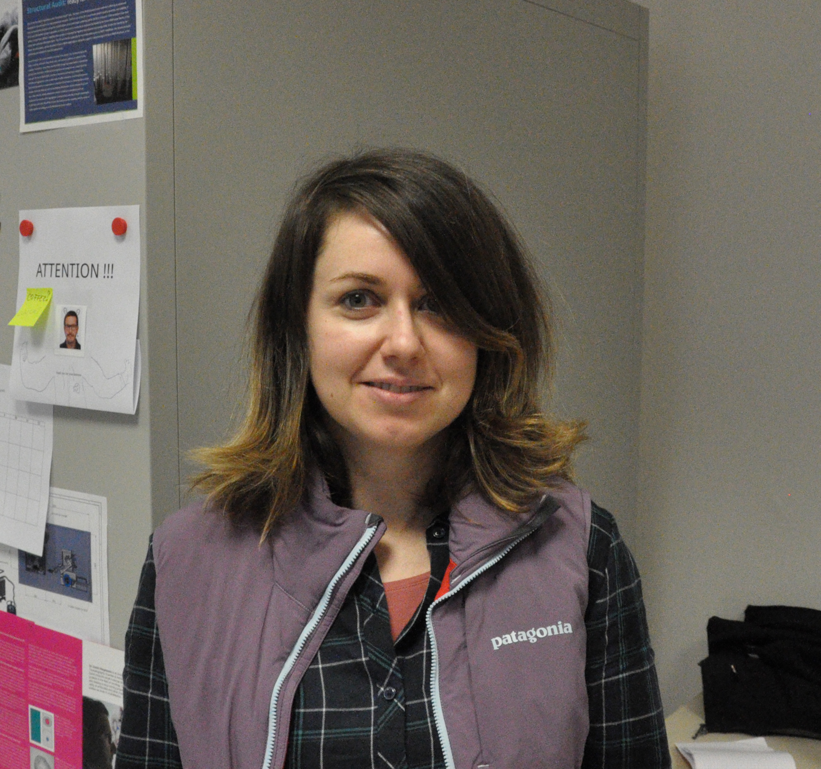
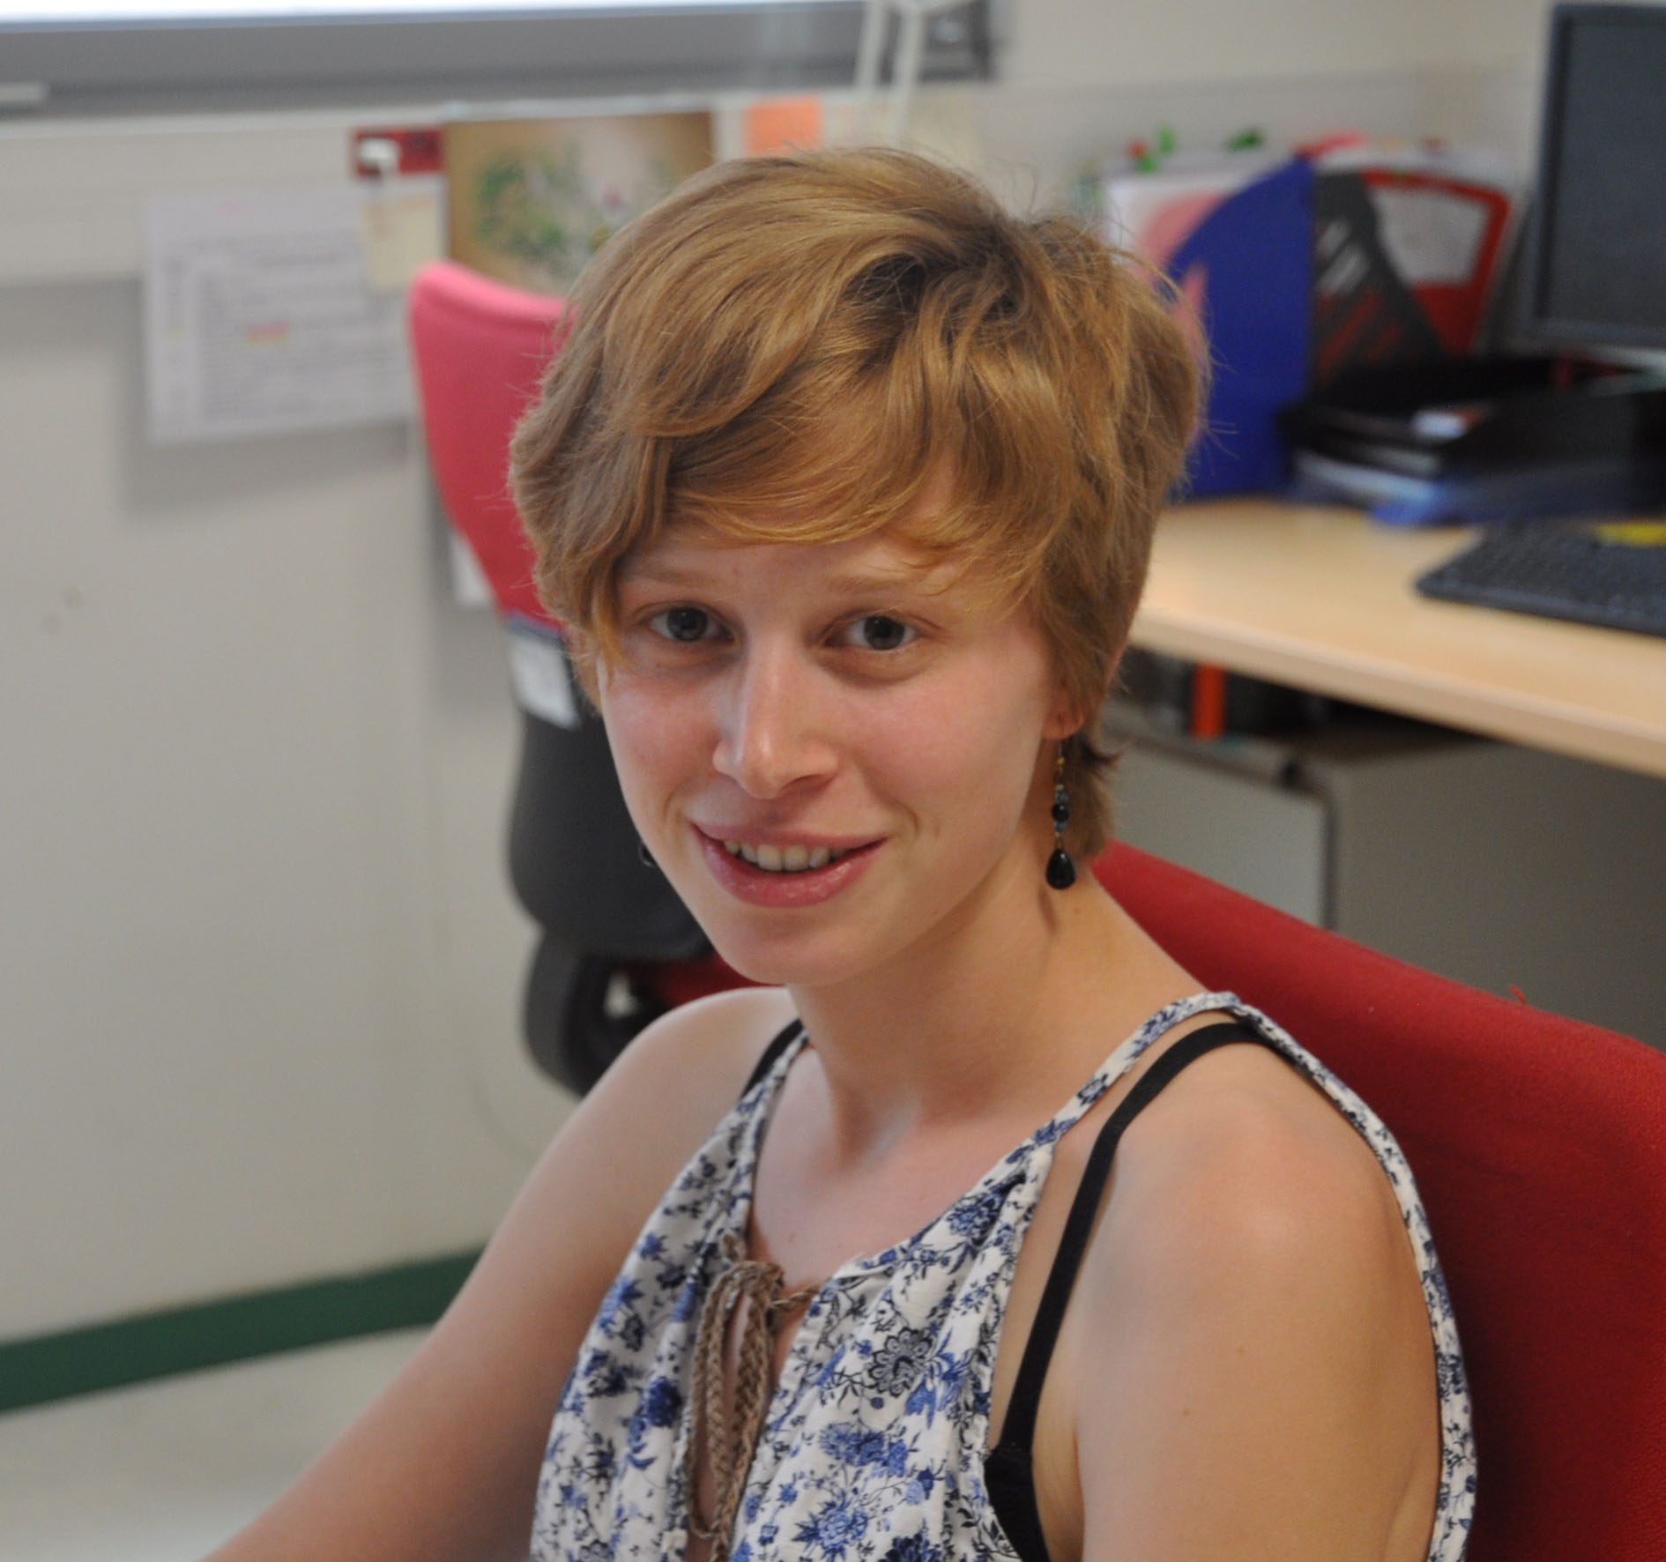
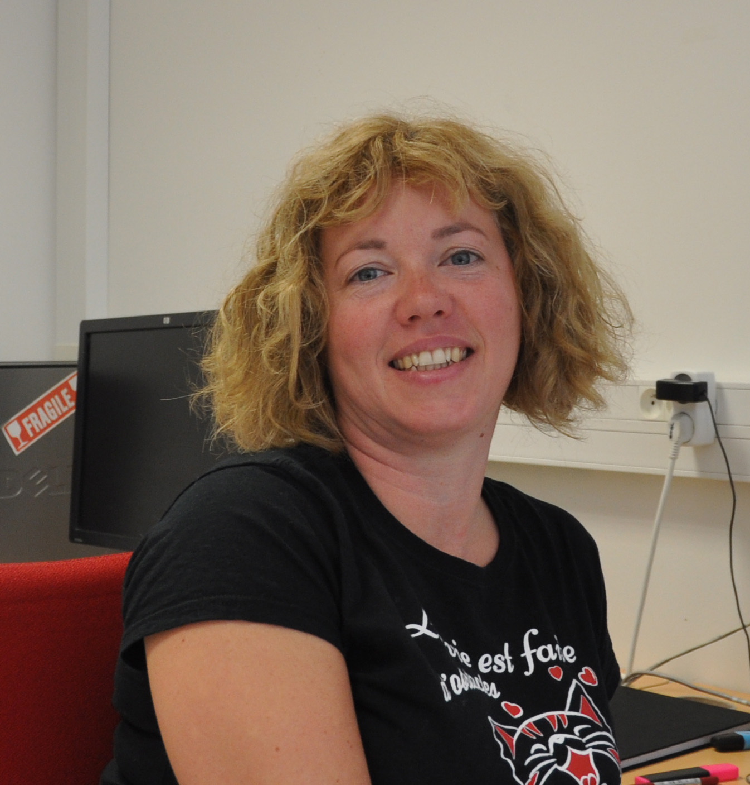
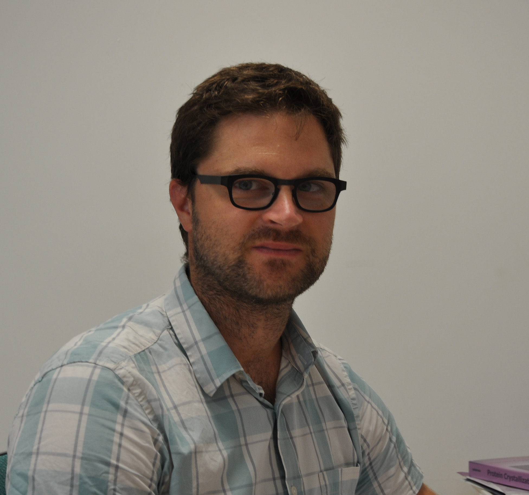
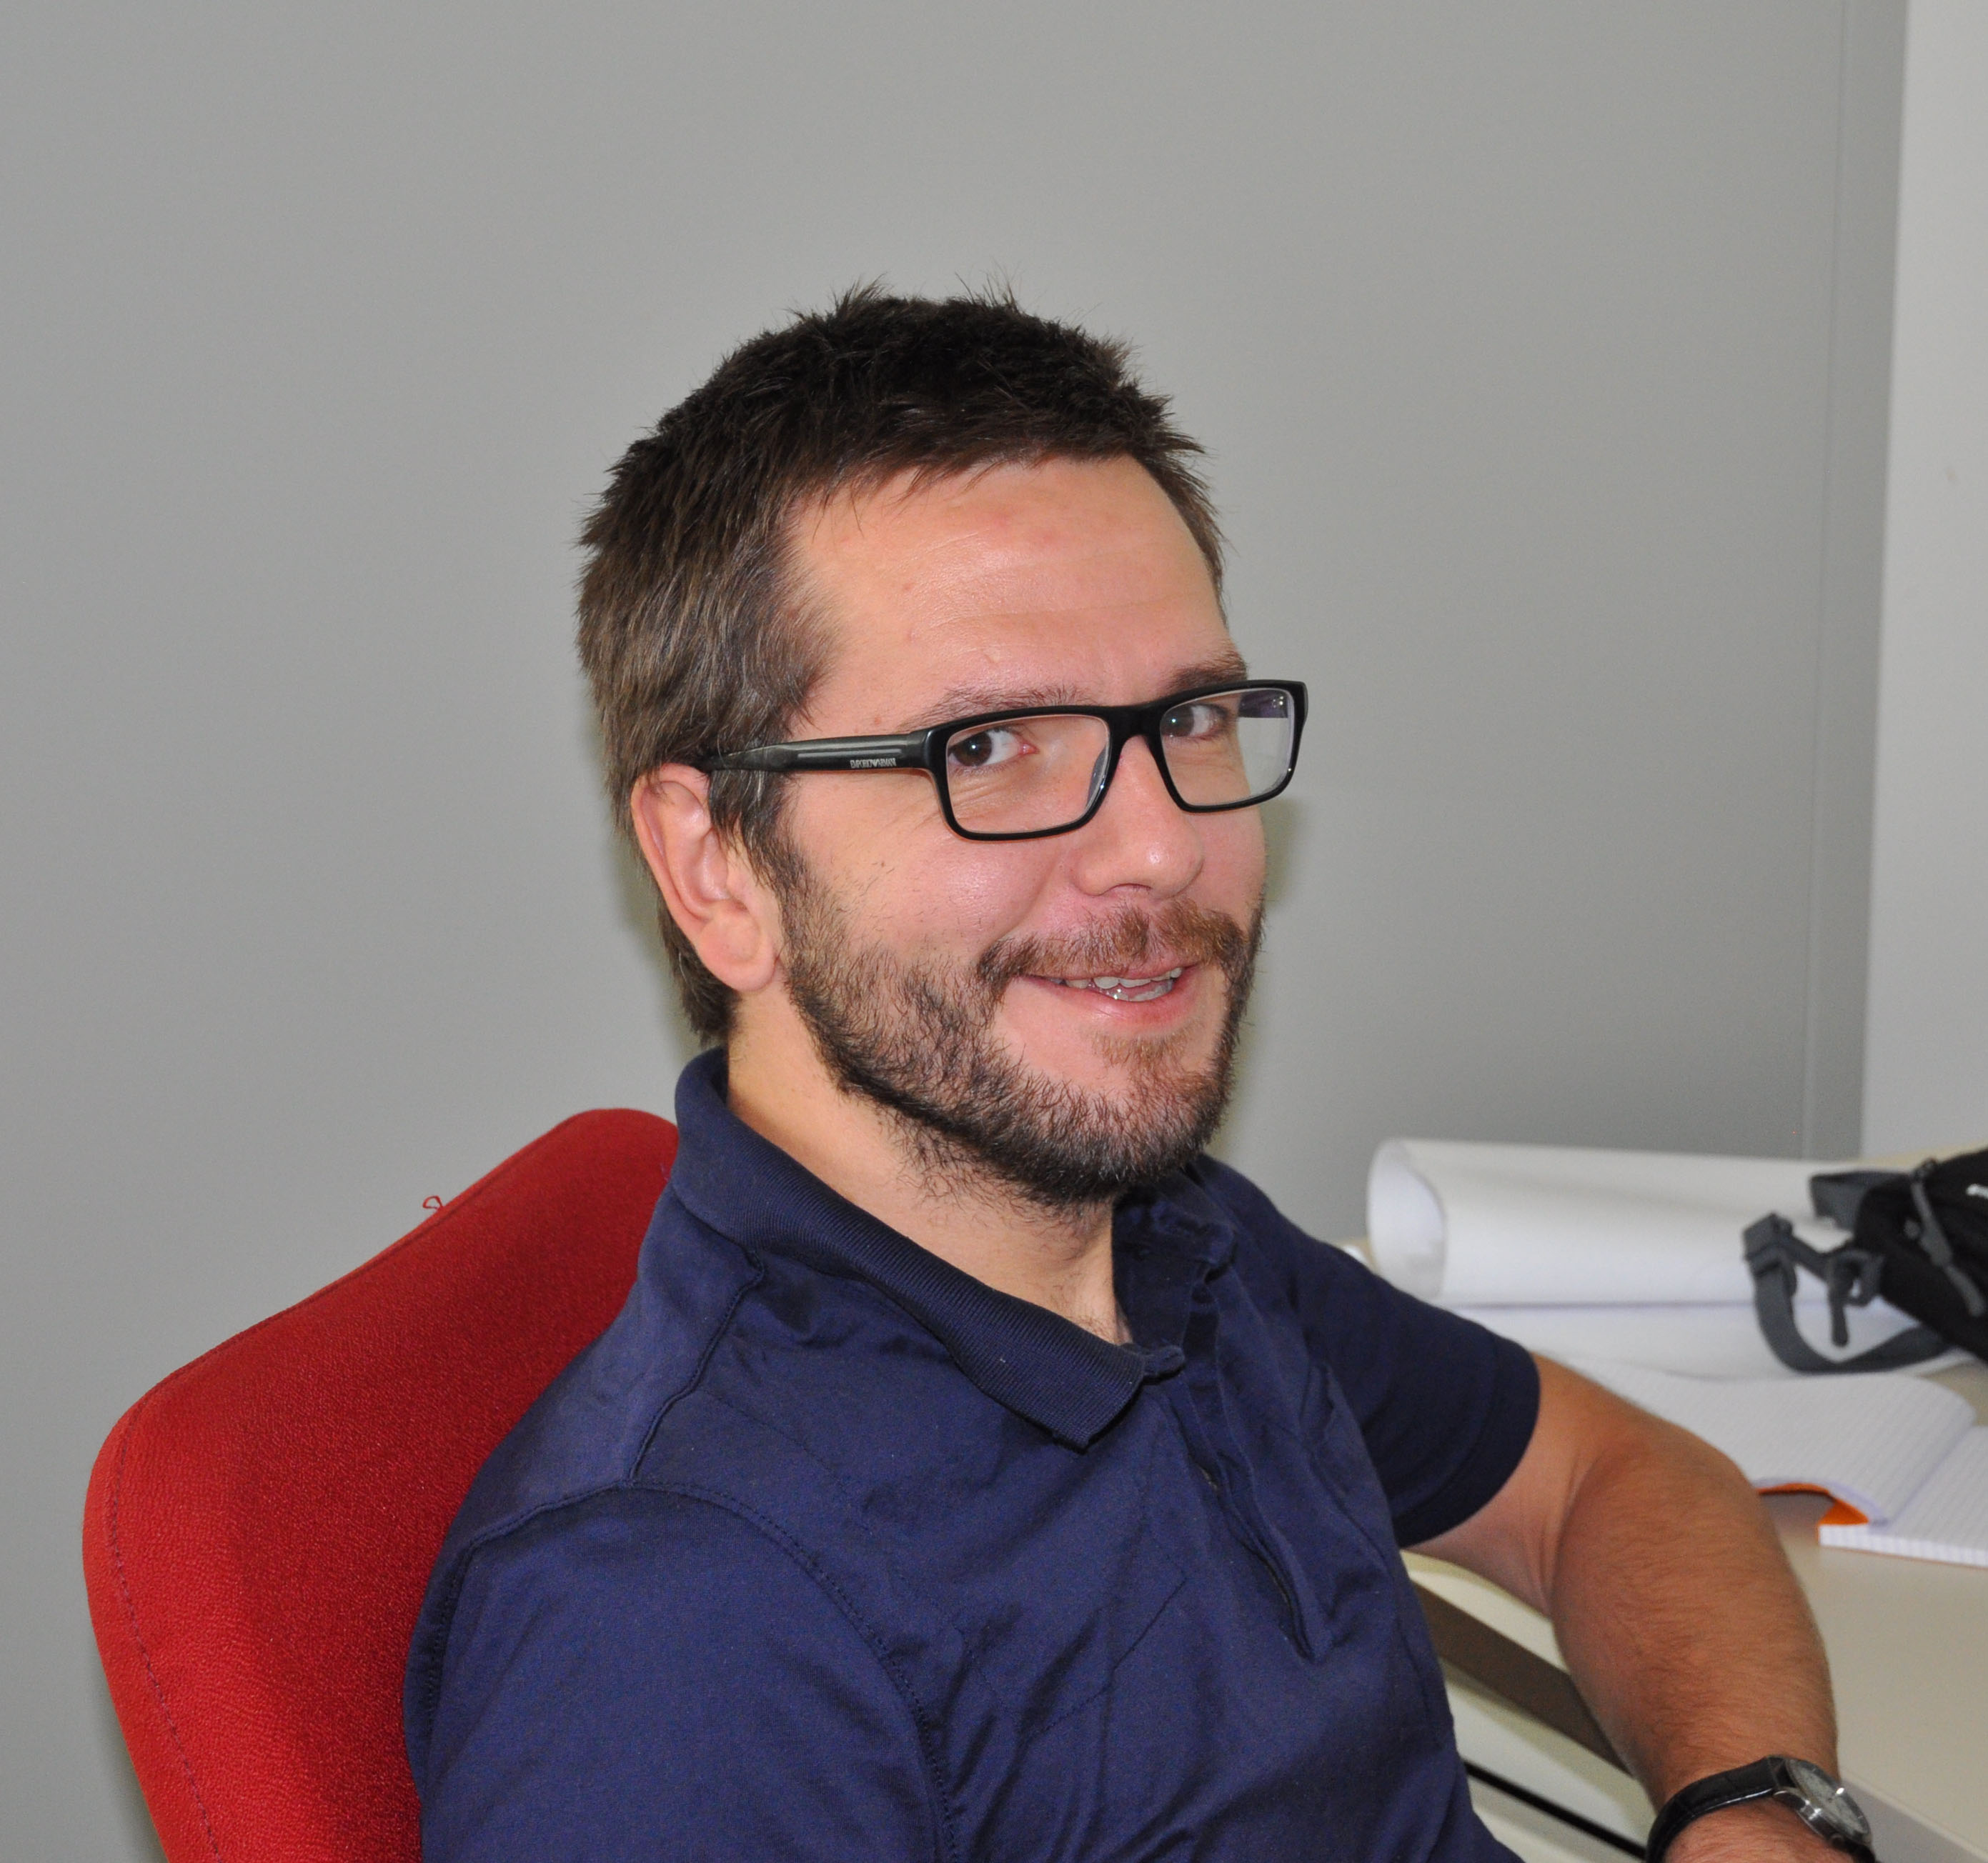
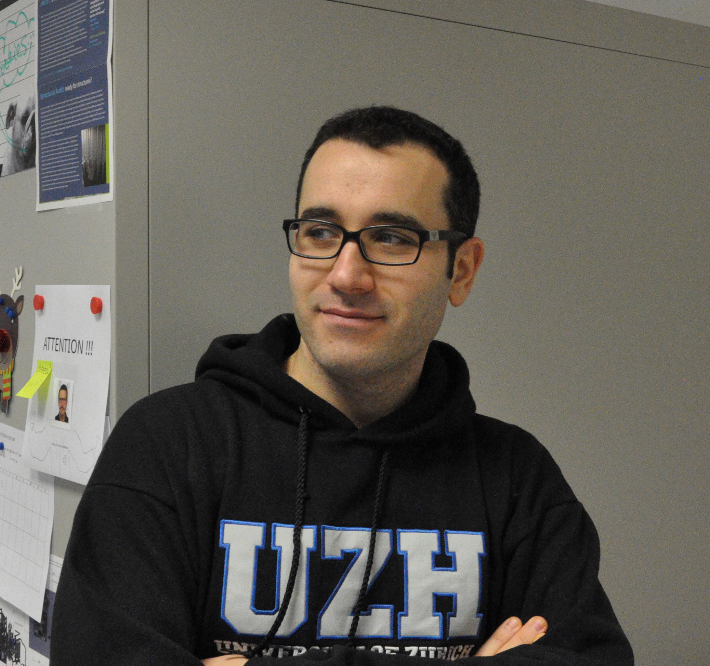
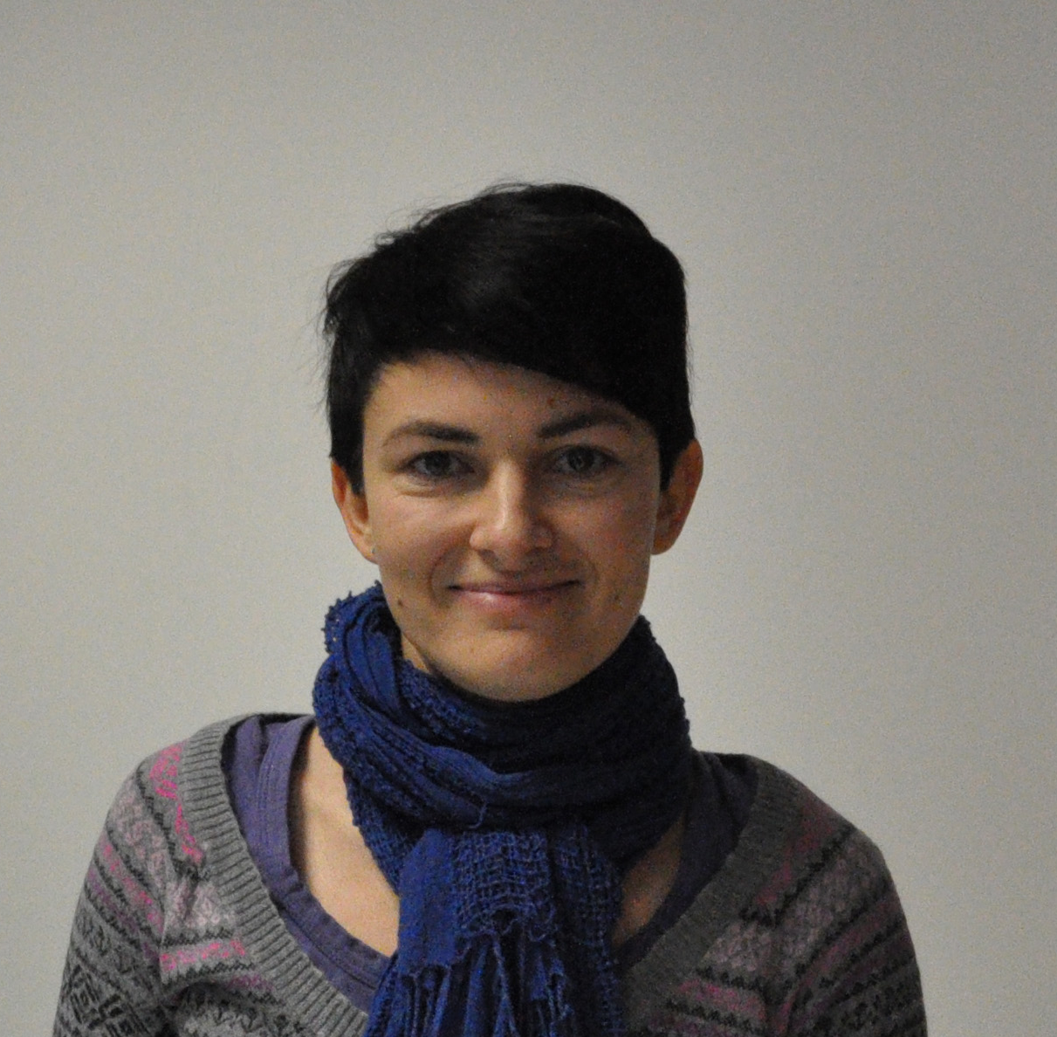
Marquez Team, EMBL Grenoble Outstation
Staff Scientist
Research Technicians
Industry Liaison Scientist
Team Leader
Software
Developers
Post-Docs

Slide 3
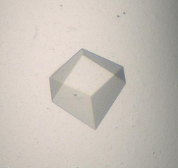
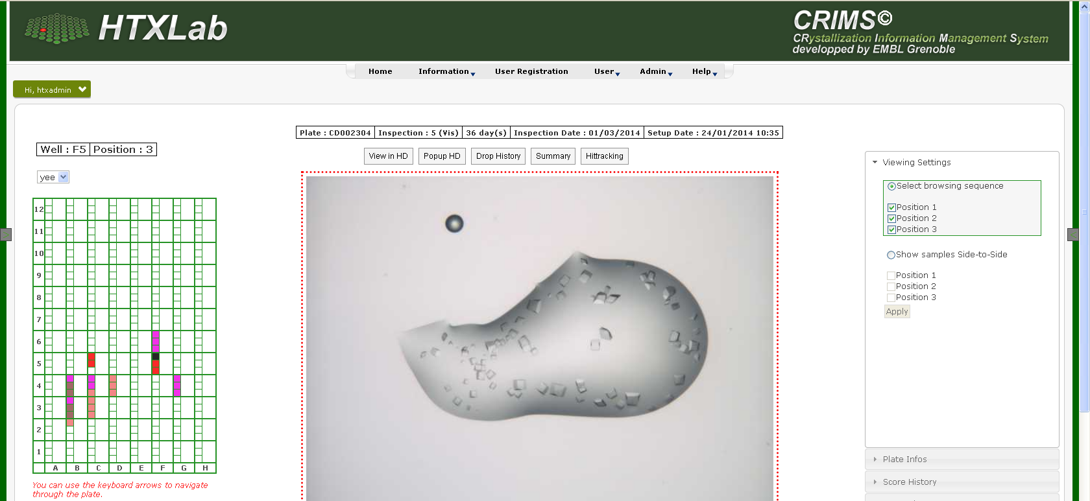
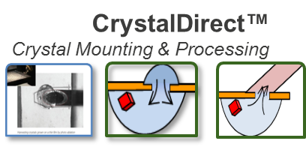
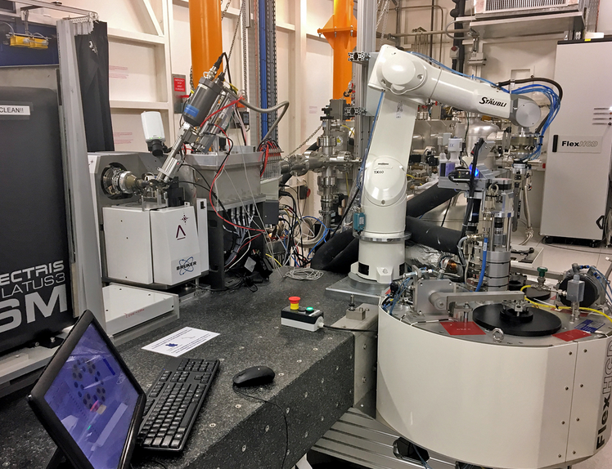
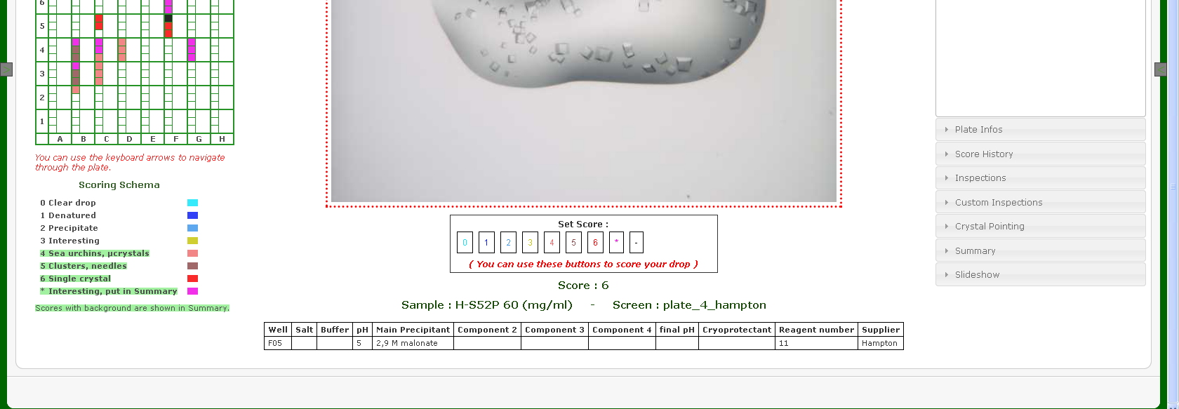
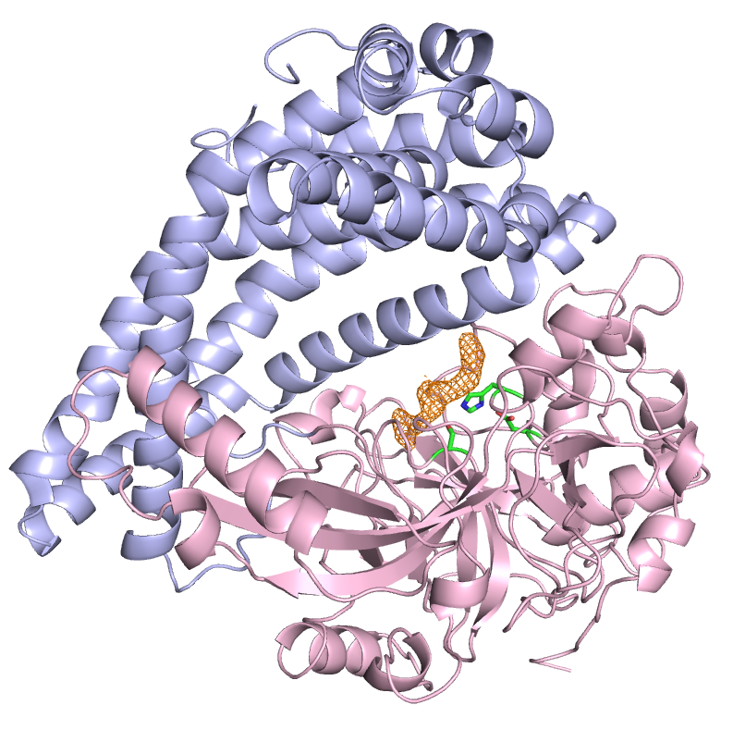
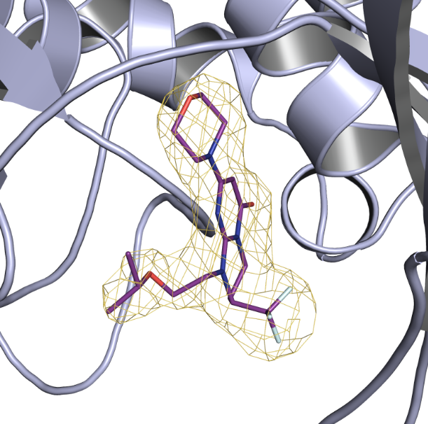
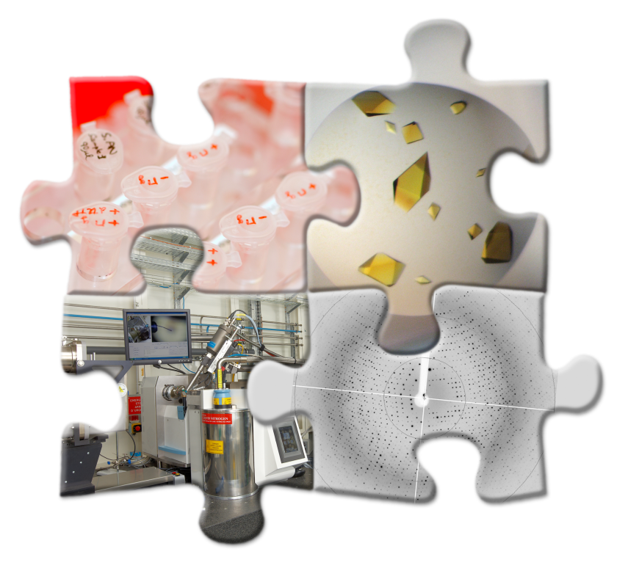
Marquez Team, EMBL Grenoble Outstation
The HTX Lab
Automated, remote-controlled crystallization
Services
Data Management
Automated Crystallography
Installed in 10 labs in Europe!
protein-to-structure
pipelines
Research
Notes:
for managing crystallization platform.

Slide 4
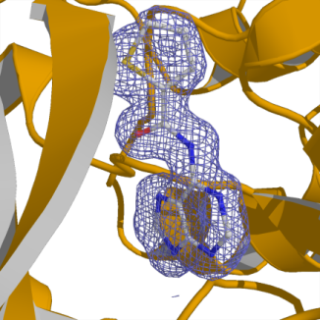
Integrated Protein-to-Structure Pipelines
Fully Automated Remote controlled
High-Throughput crystallization
Automated crystal harvesting & soaking
Automated data collection
& data processing
Hits
Notes:
The development of CrystalDirect has changed a lot what we could offer as a crystallization facility filling the gap between the preparation of the crystals and the data collection and processing pipeline offered by the MASSIF technology in collaboration with ESRF.
Highlight the importance of CRIMS-ISPyB communication

Slide 5
Home Lab - Synchrotron communication
Automated data tracking
easier to handle many samples
reducing human error
Direct link between crystallization and data collection results
Supporting automated applications
Large scale fragment screening
Complex sample processing and data analysis
…

Slide 6
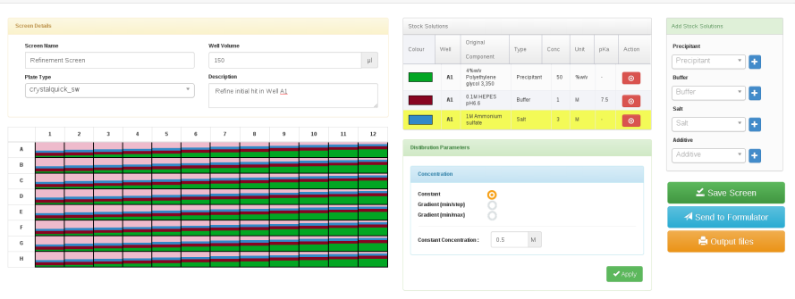
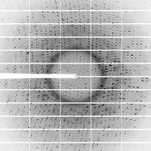
Online Crystallography
Design
Scoring
QC
Scoring
Experiment
Design
Hit optimization
Screening
Optimization
Data Collection

Slide 7
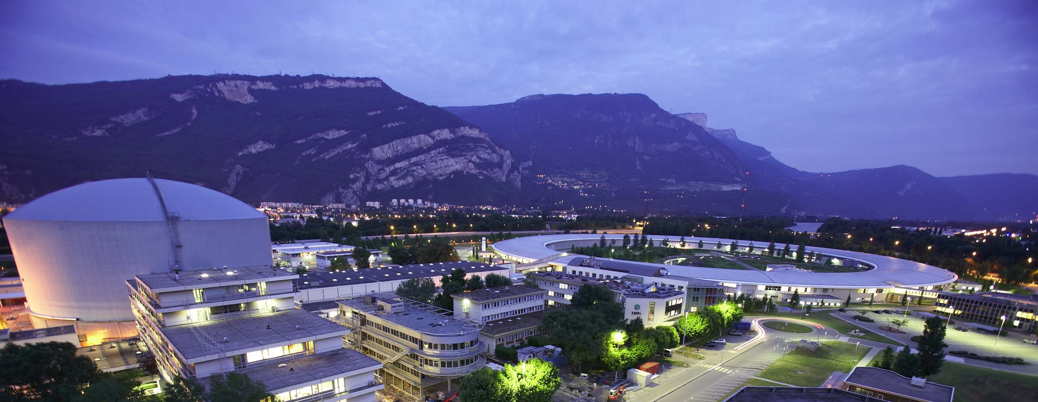

Slide 8
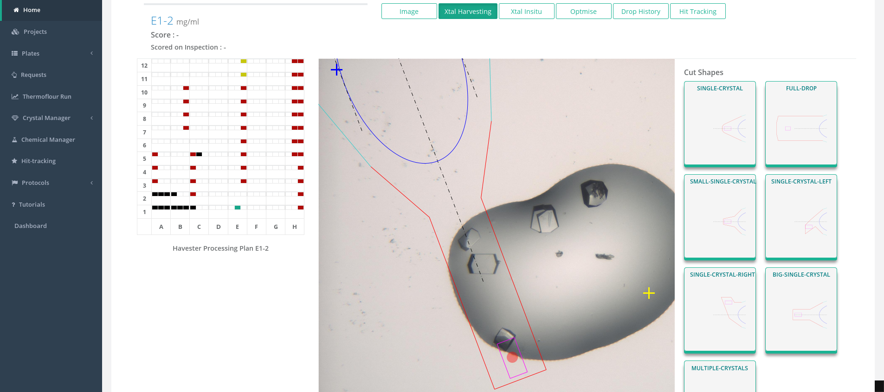
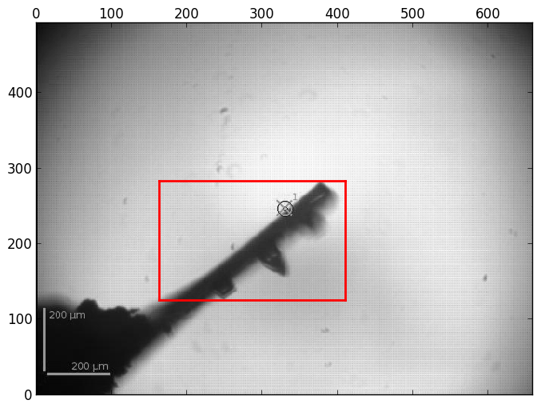
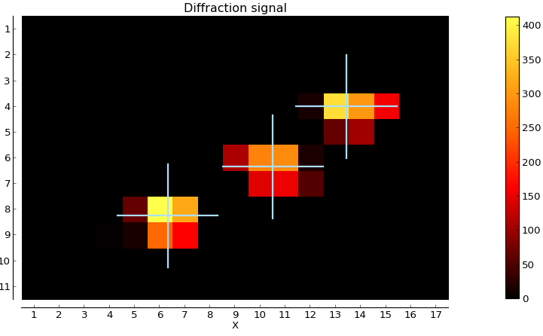
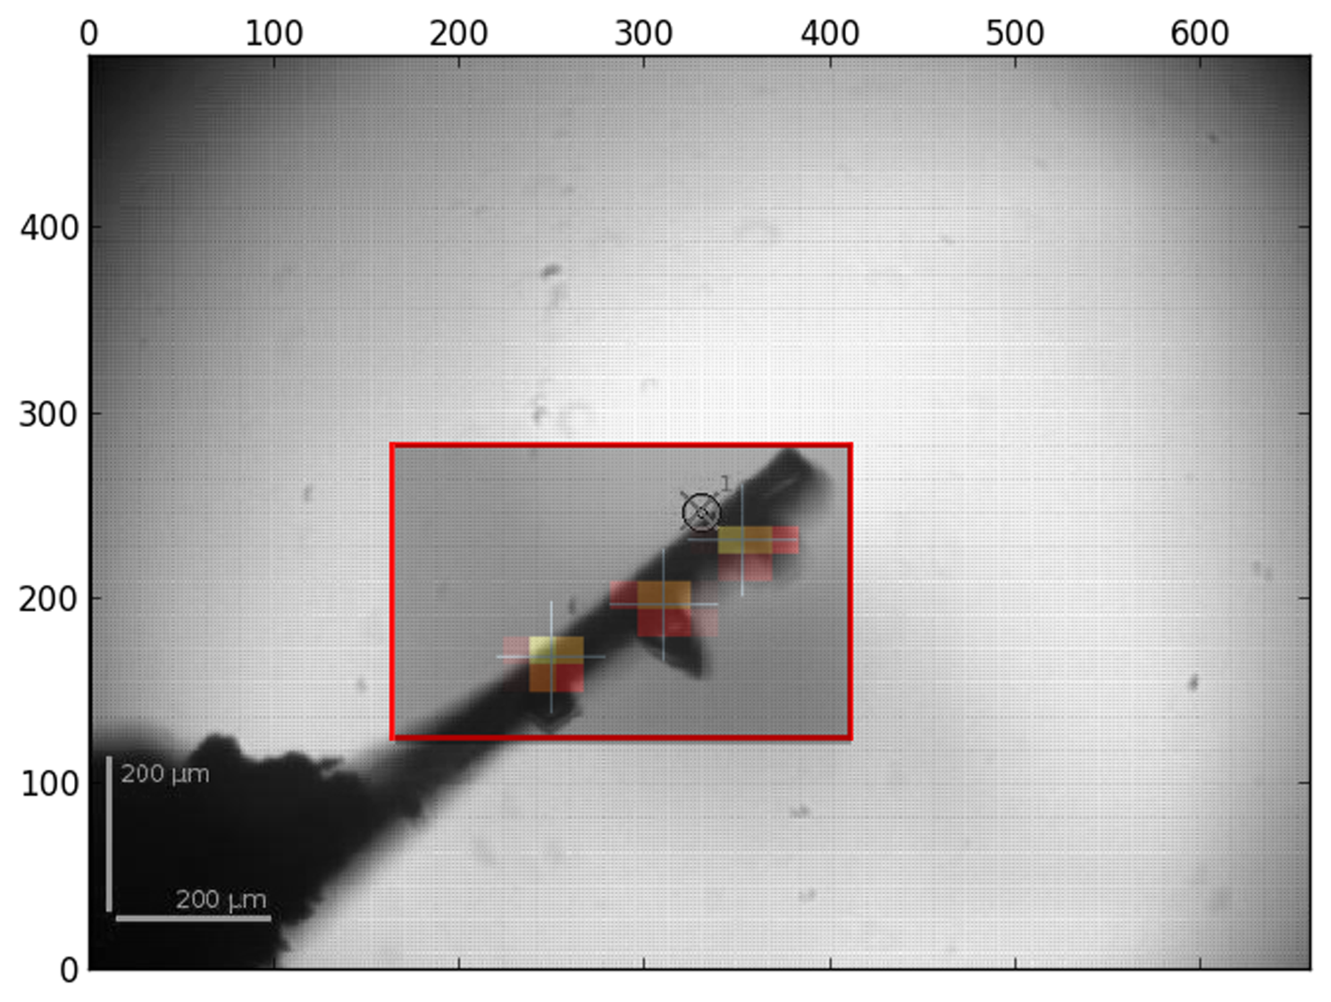
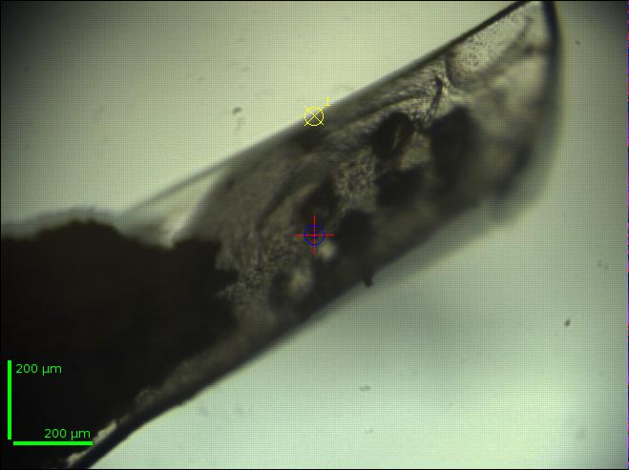
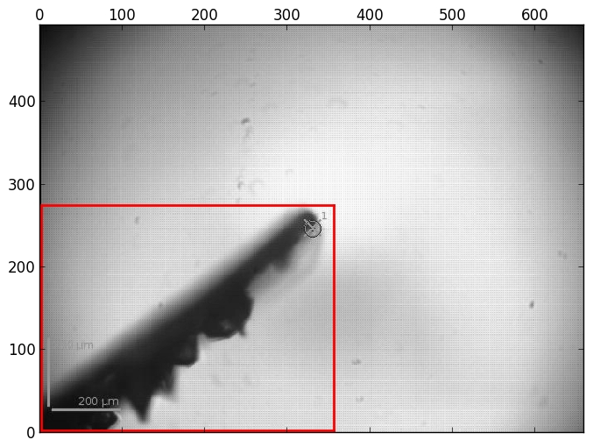
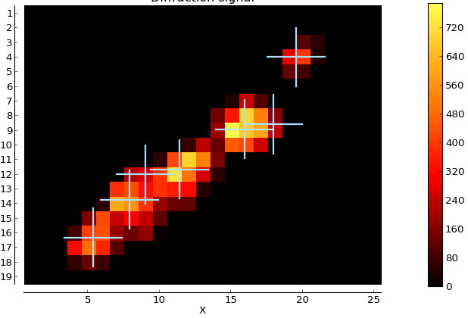
Multi-crystal data collection
MASSIF1 Beamline
6 crystals!

Slide 9
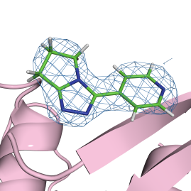
Integrated Pipelines for Ligand Screening
High Throughput Crystallization
Large amount of crystals sent to synchrotrons
Crystal pedigree important for data processing
Automated Crystal Soaking & Harvesting
Automated Data Collection (MASSIF, ESRF)
Automated Data Processing & Ranking
PIPEDREAM
autoPROC
Buster
Rhofit
Gérard Bricogne
Andrew Sharff
Clemens Vonrhein
Leigh Carter
Notes:
lead to one of the main development this year, the CRIMS ligand module

Slide 10
Advantages
Rapid preparation of synchrotron shipments
automatic association of sample acronyms, sample names and proposal number
link to crystallization images
definition of data collection parameters
Automatic link between data collection and crystallization experiments
Managing more projects with more and more samples

Slide 11
Future developments
Transferring crystal coordinates to MXCuBE for fast crystal centring
Automation of in situ data collection
Implementing crystal groups and priorities
Standardize the API protocol for allowing seamless communication of multiple home labs with different synchrotrons

Slide 12
Acknowledgement
HTX Team
José A. Márquez
Irina Cornaciu
Zuzanna Kaczmarska
Guillaume Hoffmann
Damien Clavel
Peter Murphy
Michał Jamróz
Anne-Sophie Humm
Vincent Mariaule
Florine Dupeux (IBS)
Instrumentation Team
Florent Cipriani
Jeremy Sinoir
Gergely Papp
Franck Felisaz
Marcos Lopez-Marrero
Robert Janocha
Clement Sorez
Christopher Rossi
Synchrotron Crystallography Team
Andrew McCarthy
Matthew Bowler
Ulrich Zander
ESRF
Gordon Leonard
Didier Nurizzo
Christoph Mueller-Dieckmann
Olof Svensson
Stephanie Malbet-Monaco
Alejandro De Maria Antolinos
Solange Delageniere
Global Phasing Ltd.
Gérard Bricogne
Clemens Vonrhein
Andrew Sharff
Leigh Carter

Slide 13
Thank you for your attention

